Slide 1
MySQL Assignment

Slide 2

Camera Expectations

Slide 3



Before we start… Please have your camera switched on.
Camera Expectations
This is a mandatory requirement for the duration of the course.
You are studying a regulated qualification, your tutor needs to see that it is the right person participating throughout the course.
Our job is to prepare you for work in an age where in almost any job there is likely to be at least some aspect of remote engagement with your employer.
Online learning is to be treated the same way as a classroom learning, you must be physically visible to interact with your tutor and other learners in order to create an engaging group dynamic.

Slide 4


Background filters
If you do not wish to have your camera displaying your personal environment, Microsoft Teams has a solution to this problem…
Step One: Before you join a Teams video call, click the ‘Background Filters’ option.
Step Two: On the right-hand side, you can select any of the stock images.
Step Three: The image you choose will then appear in your background on the video call.
If you need any further support in regards to this requirement, please speak to your tutor directly.

Slide 5
Areas of focus
Working as a team.
Improving problem solving skills.
Collaboration.
MySQL syntax and query writing.
Filtering and sorting in MySQL
Working on schemas
Understanding PK and FK.
Creating Relational Database Schema.

Slide 6
Assignment Instructions
Divide students into groups.
Each group needs to follow the instructions on the remaining slides.
Then each team member needs to write one additional query.
Students must submit a word document with step-by-step instructions on what they did accompanied by screenshots.
Students must submit their MySQL script.

Slide 7
Query 1
Connect to the database and view the customer table.
#Connect to the Database named &#39;store and view the customer view the customer table.
USE store;
#SELECT all records from the table named &#39;customers&#39;.
SELECT*FROM Customers;
# Arrange customer&#39;s names in ascending order
### SELECT *FROM Customers ORDER BY first_name;
# Records of customer&#39;s born after &#39;01-01-1990&#39;
# Create a new query to find all the customers with a birth date of &gt; &#39;1990-01-01&#39;
SELECT*FROM Customers WHERE birth_date &gt; &#39;1990-01-01&#39;;
SELECT * FROM Customers WHERE first_name LIKE &#39;A%&#39;AND last_name LIKE&#39;R%&#39;;
##########~SELECT MIN (point)FROM Customers;
-- There are--
SELECT MIN(points),MAX(points) FROM CUSTOMERS;
SELECT city FROM Customers WHERE first_name= &#39;Levy&#39; AND last_name= &#39;Mynett&#39;;
#The product table was found in the SCHEMAS on the left hand side
SELECT* FROM products;
#Name of products between 3 and 8
SELECT name FROM products WHERE unit_price BETWEEN 3 AND 8;
SELECT* FROM orders;
SELECT status FROM orders WHERE customer_id=7;

Slide 8
Query 1 Continued…
Arrange first_name in ascending order.
INSERT INTO ``
(`customer_id`,`first_name`,`last_name`,`birth_date`,`phone`,`address`,`city`,`state`,`
points`) VALUES (4,&#39;Ambur&#39;,&#39;Roseburgh&#39;,&#39;1974-04-14&#39;,&#39;407-231-8017&#39;,&#39;30 Arapahoe
Terrace&#39;,&#39;Orlando&#39;,&#39;FL&#39;,457);
INSERT INTO ``
(`customer_id`,`first_name`,`last_name`,`birth_date`,`phone`,`address`,`city`,`state`,`
points`) VALUES (1,&#39;Babara&#39;,&#39;MacCaffrey&#39;,&#39;1986-03-28&#39;,&#39;781-932-9754&#39;,&#39;0 Sage
Terrace&#39;,&#39;Waltham&#39;,&#39;MA&#39;,2273);
INSERT INTO ``
(`customer_id`,`first_name`,`last_name`,`birth_date`,`phone`,`address`,`city`,`state`,`
points`) VALUES (5,&#39;Clemmie&#39;,&#39;Betchley&#39;,&#39;1973-11-07&#39;,NULL,&#39;5 Spohn
Circle&#39;,&#39;Arlington&#39;,&#39;TX&#39;,3675);
INSERT INTO ``
(`customer_id`,`first_name`,`last_name`,`birth_date`,`phone`,`address`,`city`,`state`,`
points`) VALUES (6,&#39;Elka&#39;,&#39;Twiddell&#39;,&#39;1991-09-04&#39;,&#39;312-480-8498&#39;,&#39;7 Manley
Drive&#39;,&#39;Chicago&#39;,&#39;IL&#39;,3073);
INSERT INTO ``
(`customer_id`,`first_name`,`last_name`,`birth_date`,`phone`,`address`,`city`,`state`,`
points`) VALUES (3,&#39;Freddi&#39;,&#39;Boagey&#39;,&#39;1985-02-07&#39;,&#39;719-724-7869&#39;,&#39;251 Springs
Junction&#39;,&#39;Colorado Springs&#39;,&#39;CO&#39;,2967);
Notes:
Run the query

Slide 9

Query 2
Create a new query to find all the customers with a birth date of > '1990-01-01'
INSERT INTO ``
(`customer_id`,`first_name`,`last_name`,`birth_dat
e`,`phone`,`address`,`city`,`state`,`points`)
VALUES (6,&#39;Elka&#39;,&#39;Twiddell&#39;,&#39;1991-09-04&#39;,&#39;312-480-
8498&#39;,&#39;7 Manley Drive&#39;,&#39;Chicago&#39;,&#39;IL&#39;,3073);
INSERT INTO ``
(`customer_id`,`first_name`,`last_name`,`birth_dat
e`,`phone`,`address`,`city`,`state`,`points`)
VALUES (8,&#39;Thacher&#39;,&#39;Naseby&#39;,&#39;1993-07-17&#39;,&#39;941-
527-3977&#39;,&#39;538 Mosinee
Center&#39;,&#39;Sarasota&#39;,&#39;FL&#39;,205);
INSERT INTO ``
(`customer_id`,`first_name`,`last_name`,`birth_dat
e`,`phone`,`address`,`city`,`state`,`points`)
VALUES (9,&#39;Romola&#39;,&#39;Rumgay&#39;,&#39;1992-05-23&#39;,&#39;559-181-
3744&#39;,&#39;3520 Ohio Trail&#39;,&#39;Visalia&#39;,&#39;CA&#39;,1486);

Slide 10
Query 3.1
Write a query to find all customers whose first_name starts with the letter Aand last_name starts with the letter M.
18/07/2023
/*
-- Query: SELECT city FROM Customers WHERE
first_name= &#39;Levy&#39; AND last_name= &#39;Mynett&#39;
LIMIT 0, 1000
-- Date: 2023-07-18 22:22
*/
INSERT INTO `` (`city`) VALUES (&#39;Atlanta&#39;);
Record your results in your word document
Notes:
SELECT last_name, first_name, points, points * 10 + 100
FROM CUSTOMERS
SELECT last_name, first_name, points, (points + 10) * 100 as discount_factor
FROM CUSTOMERS

Slide 11
Query 3.2
Write a query to show last_name, first_name and points
In the output
*/
INSERT INTO ``
(`customer_id`,`first_name`,`last_name`,`birth_date`,`phone`,`
address`,`city`,`state`,`points`) VALUES
(4,&#39;Ambur&#39;,&#39;Roseburgh&#39;,&#39;1974-04-14&#39;,&#39;407-231-8017&#39;,&#39;30
Arapahoe Terrace&#39;,&#39;Orlando&#39;,&#39;FL&#39;,457);
Notes:
Here we have added the last name first and then the first name. The next task is to add the original point and the points pulse 10 .

Slide 12
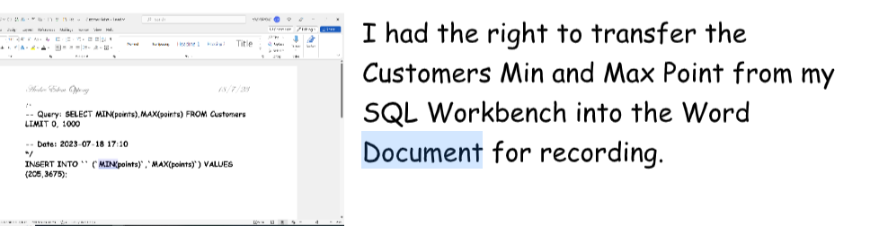
Task 3.3
Write a query to find the minimum and maximum points
Notes:
Answer
Select name , unit_price, unit_price* 1.1 AS new _price From products

Slide 13
Task 4
Which city does Levy Mynett live in?
/*
-- Query: SELECT city FROM Customers WHERE
first_name= &#39;Levy&#39; AND last_name= &#39;Mynett&#39;
LIMIT 0, 1000
-- Date: 2023-07-18 22:22
*/
INSERT INTO `` (`city`) VALUES (&#39;Atlanta&#39;);

Slide 14
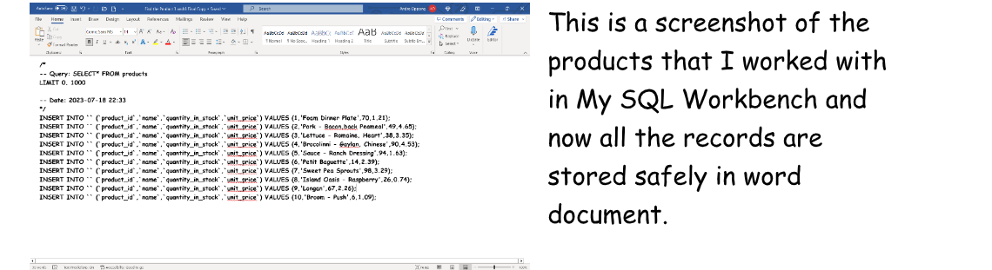
Find the products with a unit price between 3 and 8.

Slide 15
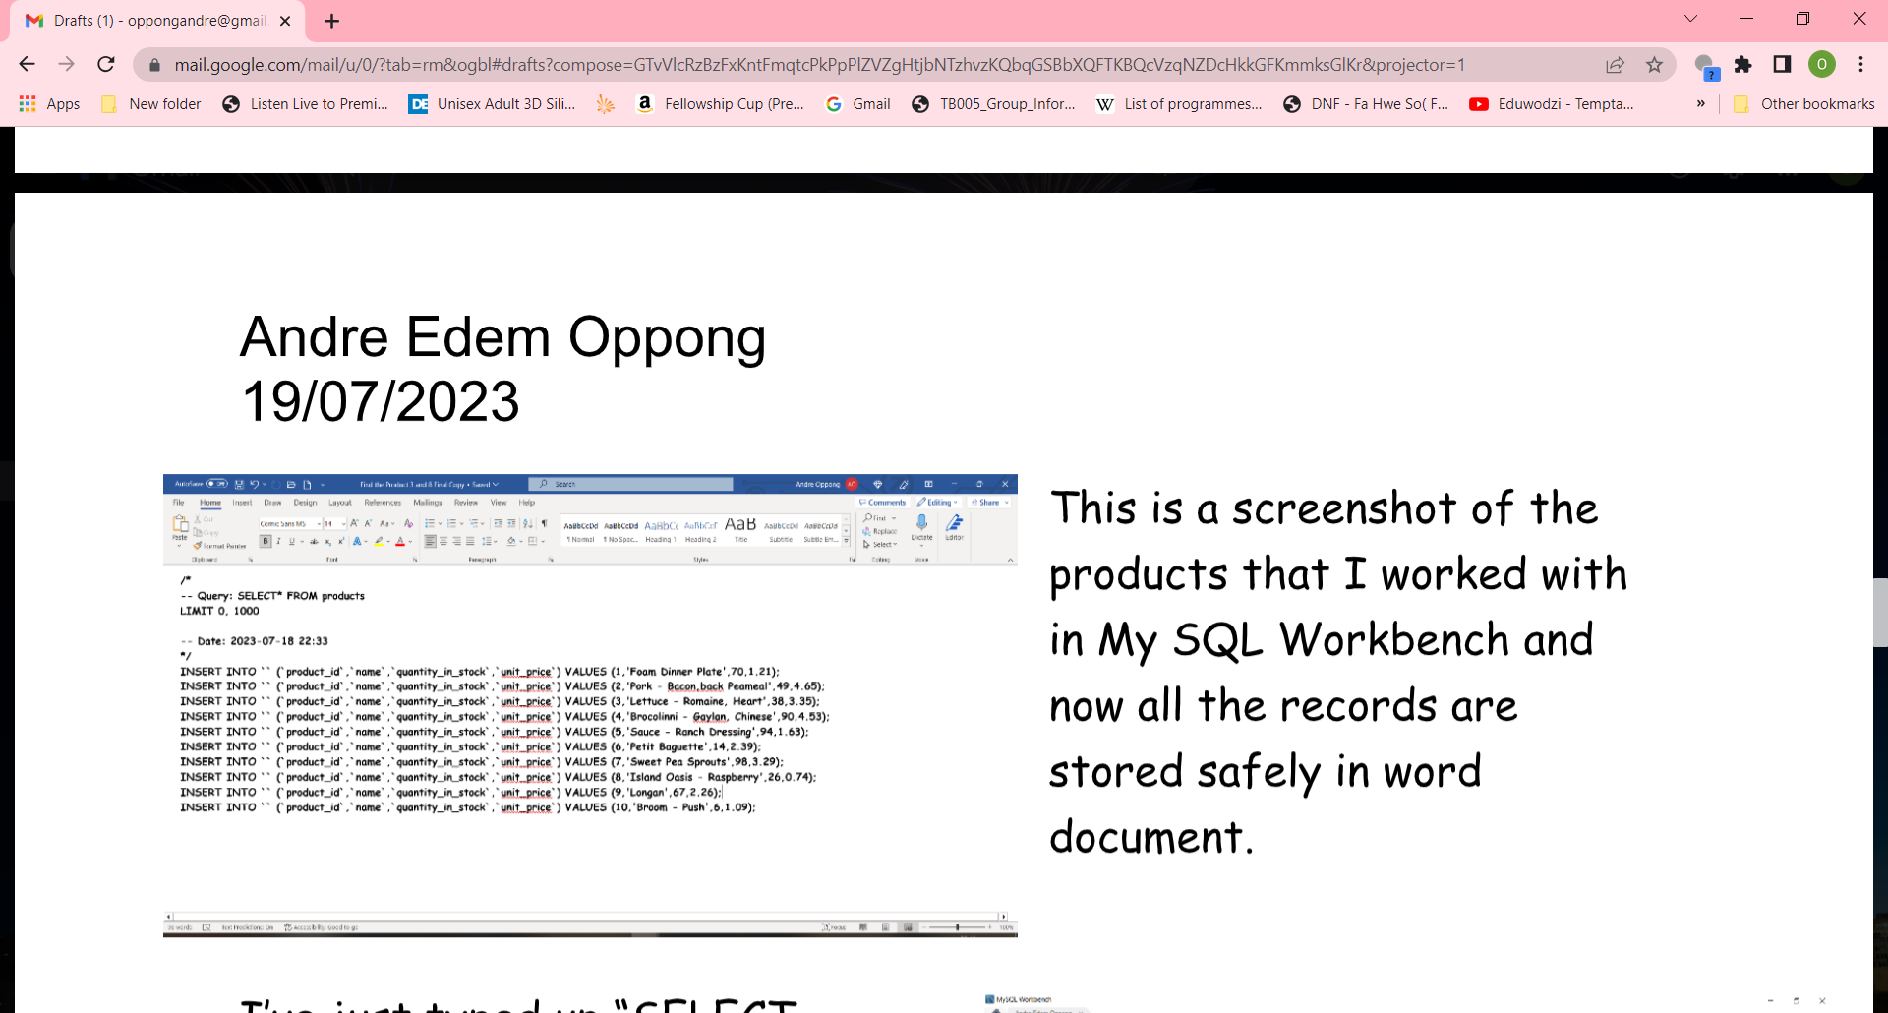
Task 5
What is the order status for customer 10?

Slide 16
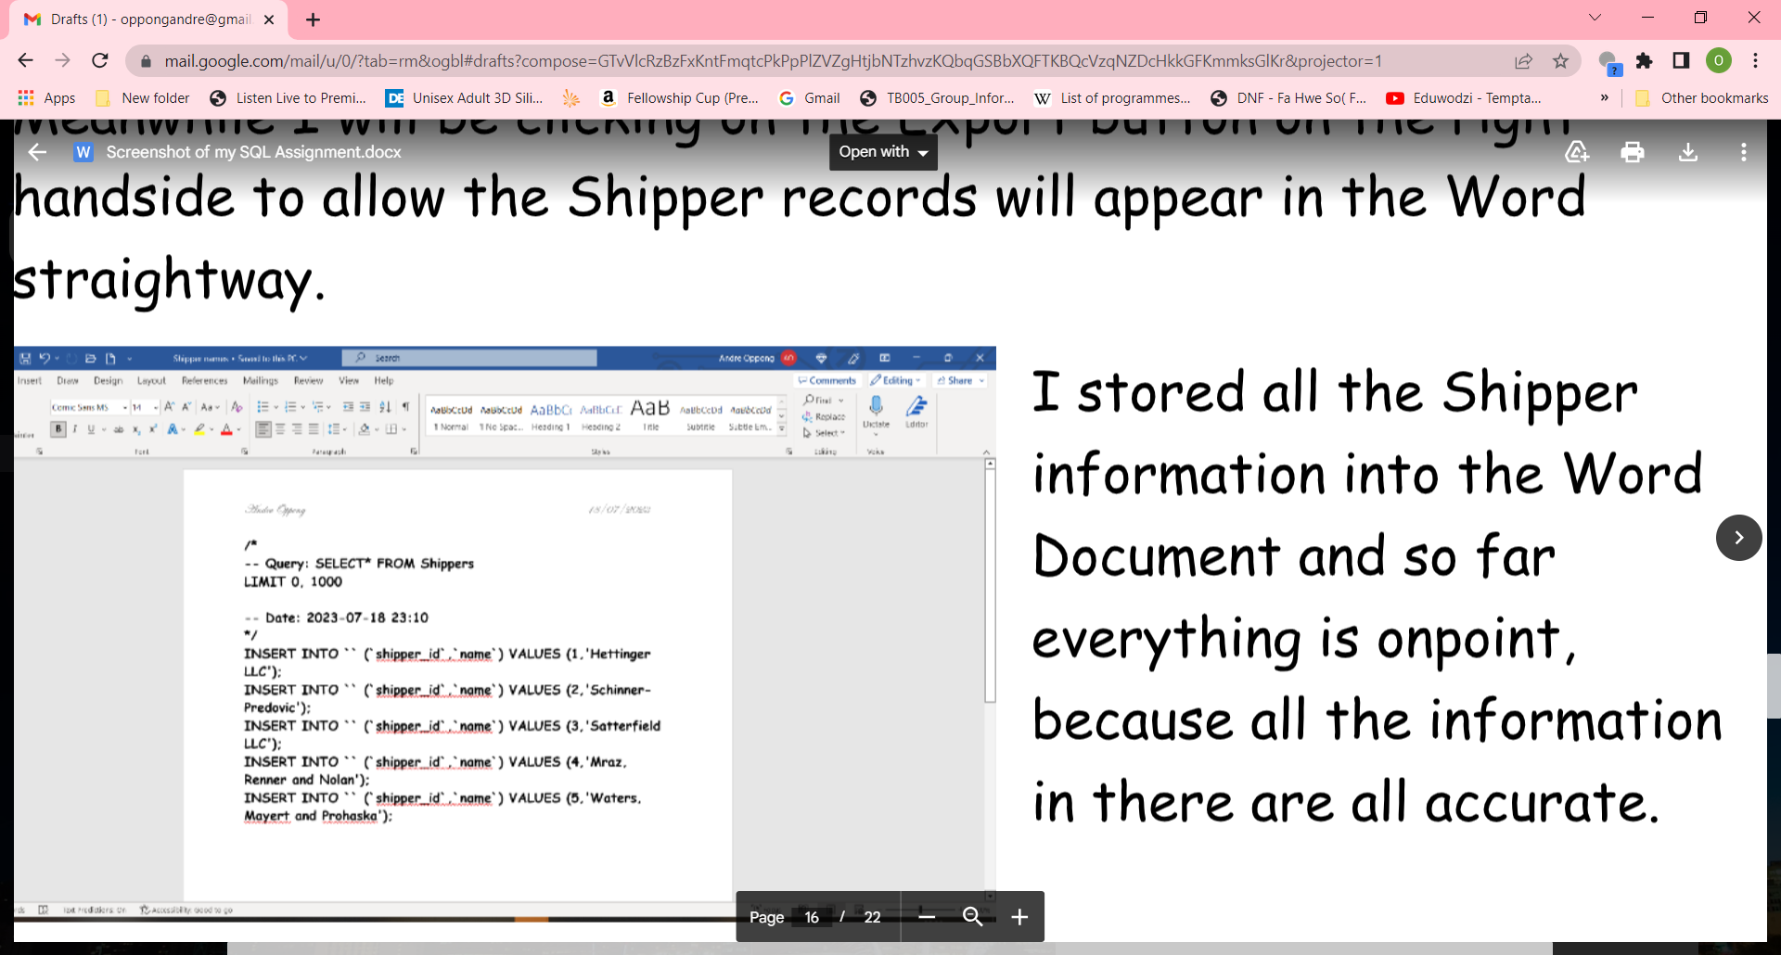
What is the name of the shipper with id 5?

Slide 17
Creating an EER Diagram

Slide 18
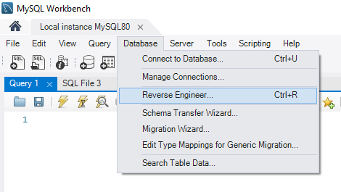

Slide 19
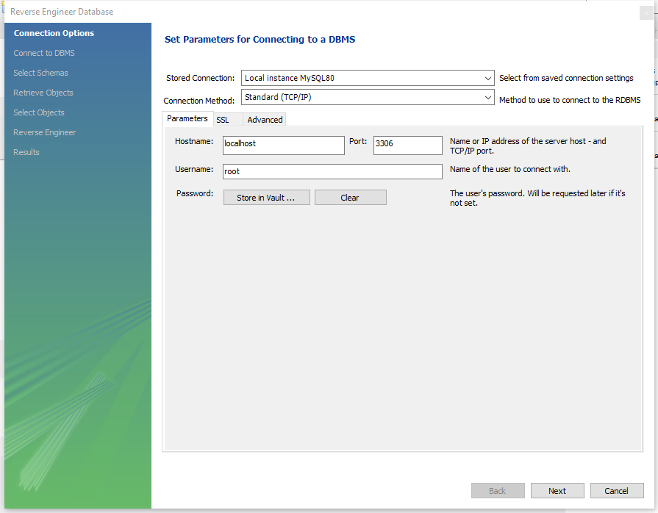

Slide 20
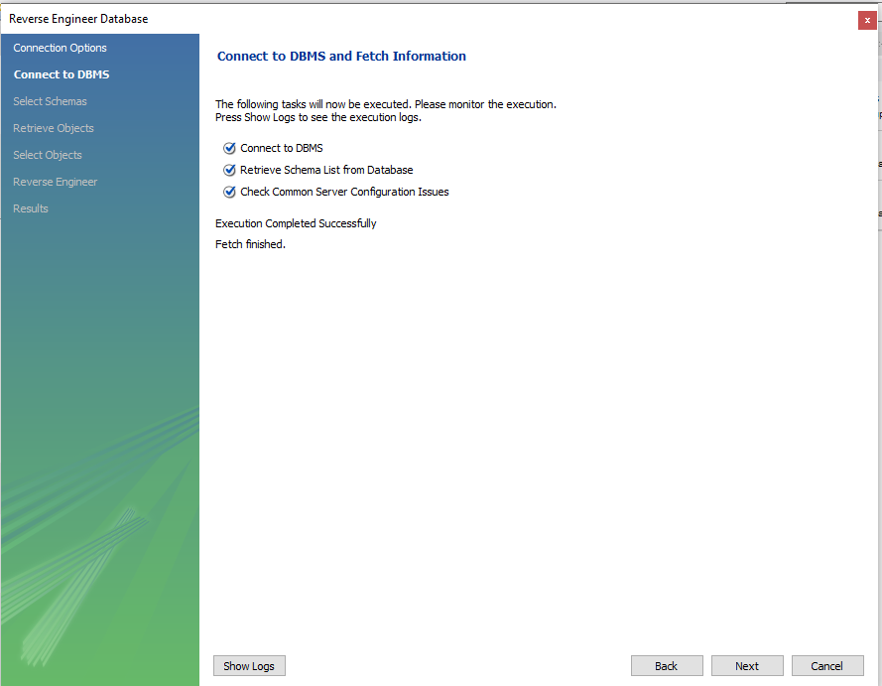

Slide 21
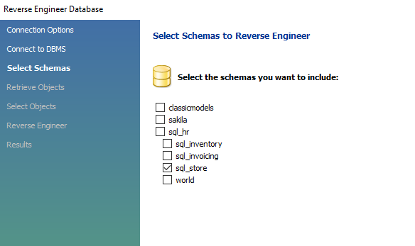
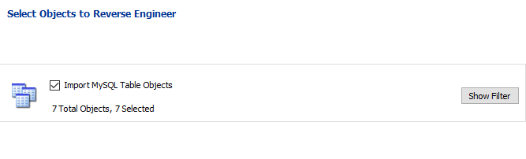

Slide 22
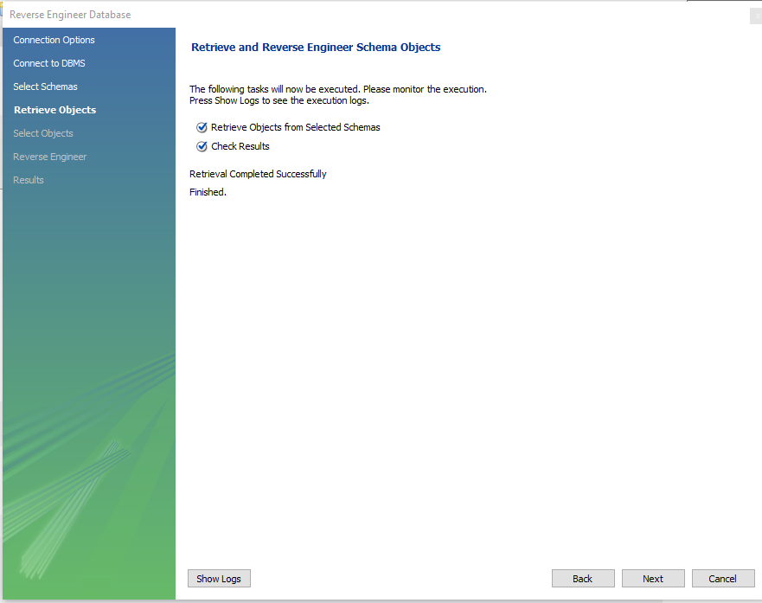

Slide 23
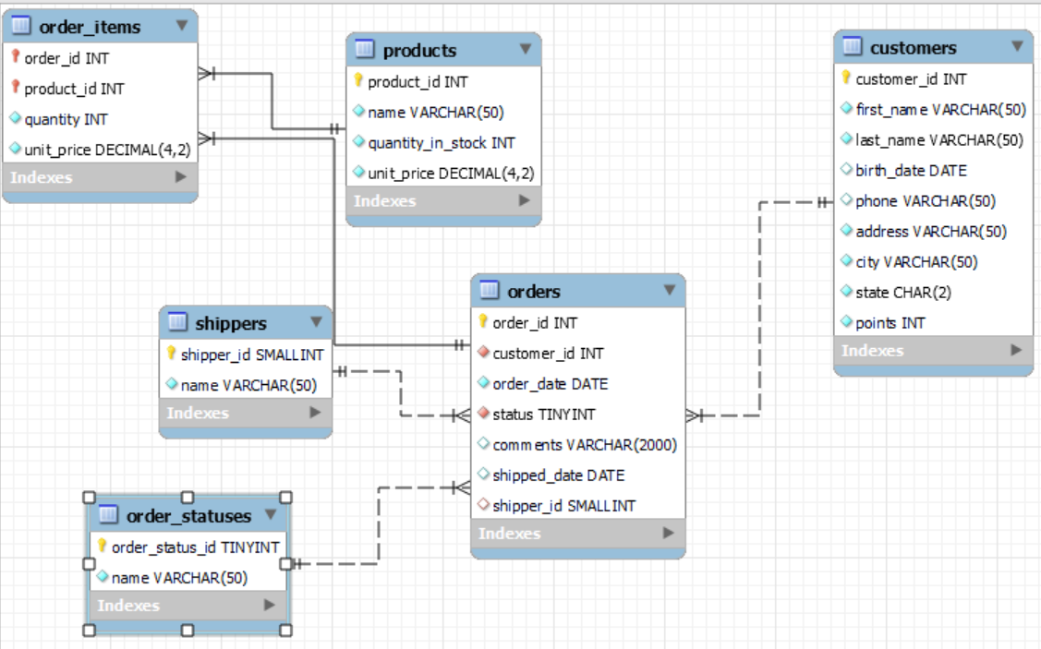
Your EER Diagram should look like this.
Rearrange you EER data to fit on one page
Identify the PRIMAR KEY for each table
Identify the FOREIGN KEY for each table

Slide 24
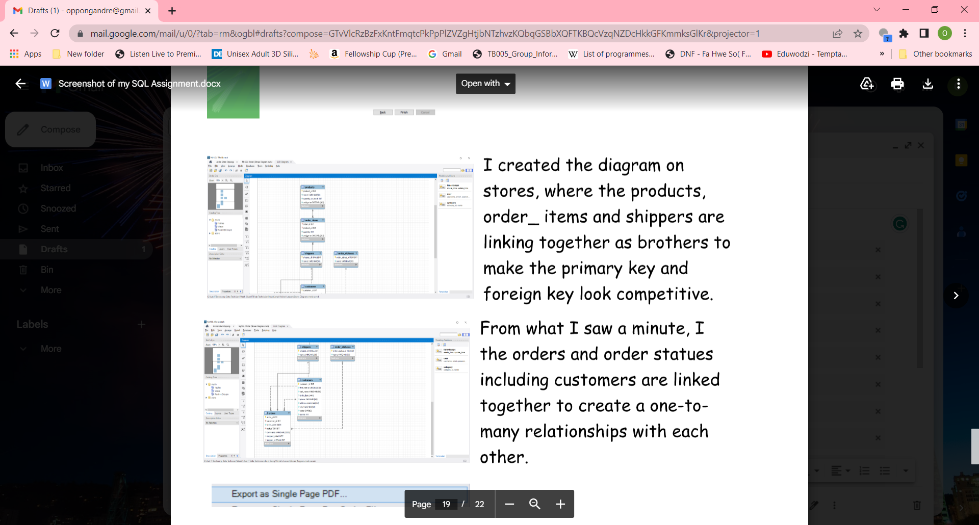
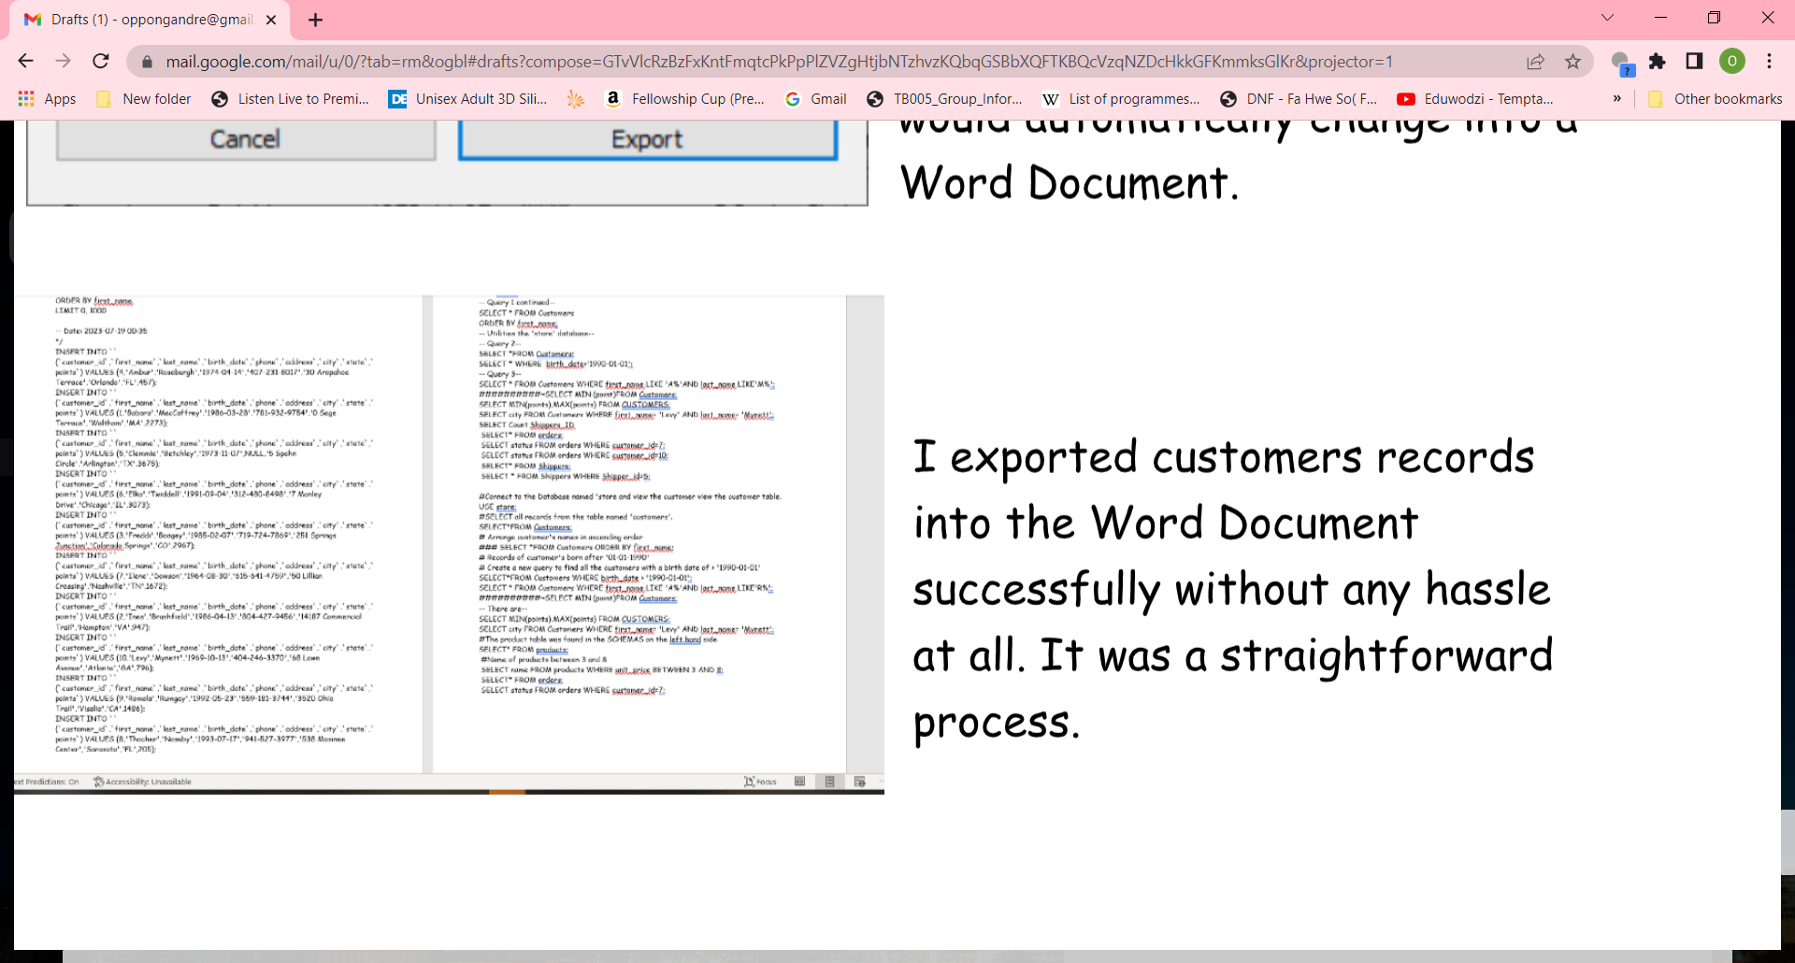
Task for distinction
To get a distinction, write additional queries that have not been asked previously.

